Slide 1
Database Course
Games Academy July 2015
Benjamin Nitschke - Delta Engine
Notes:
Database and Server Side Programming Course

Slide 2
Overview
Day 1: Traditional SQL Programming
MsSQL, MySQL, Oracle, PostgreSQL, etc.
Creation of SQL Database, Tables, Views and Logins
Using SQL Management Studio
Day 2: NoSQL Programming
NoSQL simplifies everything
MongoDB as an example
Notes:
Language does not matter, but doing this in C#, Java, Python, etc. is much easier than trying to do this in native C++, but use whatever you are comfortable with.

Slide 3
Overview
An example game (Pong with PongServer from the NetworkingCourse) is used and player accounts, high-scores and statistics support for each game session is added.
This data is saved on the server-side and used for analysis and presenting the data (e.g. high-scores) in game and on a website for the game.
Notes:
Language does not matter, but doing this in C#, Java, Python, etc. is much easier than trying to do this in native C++, but use whatever you are comfortable with.

Slide 4
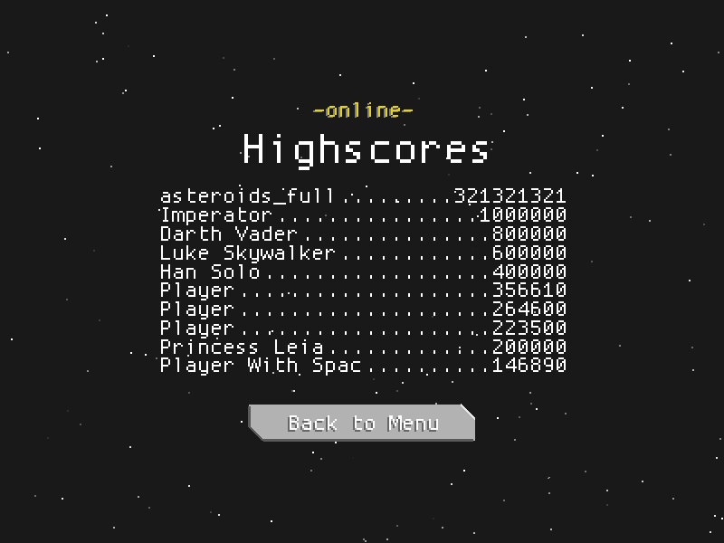
Overview
Notes:
Language does not matter, but doing this in C#, Java, Python, etc. is much easier than trying to do this in native C++, but use whatever you are comfortable with.

Slide 5
Quotes
“It takes years of experience to learn good (relational) data modeling.”
“To a database person, every nail looks like a thumb. Or something like that.” — Jamie Zawinski
“If you think it's simple, then you have misunderstood the problem.” — Bjarne Stroustrup
“One test result is worth one thousand expert opinions.” — Wernher Von Braun
Notes:
Sources: https://news.ycombinator.com/item?id=9946399
http://stgray.com/quotes/programmingquotes.html

Slide 6
Quotes
“Think about it: if you were running a multi-million dollar company, and your database of customer information was stolen, would you want to tell your clients? No. Most companies did not until the laws required them to. It's in the best interest of organisations - when they're attacked and information is stolen - to tell nobody.” - Kevin Mitnick
“Computing should be taught as a rigorous - but fun - discipline covering topics like programming, database structures, and algorithms.” - Geoff Mulgan
Notes:
Sources: https://news.ycombinator.com/item?id=9946399
http://stgray.com/quotes/programmingquotes.html
http://www.brainyquote.com/quotes/keywords/database.html

Slide 7

Quotes
Notes:
http://xkcd.com/327/
https://en.wikipedia.org/wiki/SQL_injection

Slide 8
Testing your knowledge
What does SQL stand for?
Which statement is used to extract data from a database?
Which statement is used to update data from a database?
Which statement is used to remove data from a database?
Which statement is used to add data to a database?
How to select a column “Name” from a table “User”?
How to get all data from a table “User”?
Write on paper or use //as1-ffm/pub$/Database/<YourName>
Spend max. 2 minutes on this, don’t talk or use google
Notes:
Language does not matter, but doing this in C#, Java, Python, etc. is much easier than trying to do this in native C++, but use whatever you are comfortable with.

Slide 9
Answers
What does SQL stand for?
Structured Query Language
Which statement is used to extract data from a database?
Select
Which statement is used to update data in a database?
Update
Which statement is used to remove data from a database?
Delete
Notes:
Size of Ethernet frame - 24 Bytes
Size of IPv4 Header (without any options) - 20 bytes
Size of TCP Header (without any options) - 20 Bytes
So total size of empty TCP datagram - 24 + 20 + 20 = 64 bytes
Size of UDP header - 8 bytes
So total size of empty UDP datagram - 24 + 20 + 8 = 52 byte

Slide 10
Answers
Which statement is used to add data to a database?
Insert Into
How to select a column “Name” from a table “User”?
Select Name From [User]
How to get all data from a table “User”?
Select * From [User]
Notes:
Size of Ethernet frame - 24 Bytes
Size of IPv4 Header (without any options) - 20 bytes
Size of TCP Header (without any options) - 20 Bytes
So total size of empty TCP datagram - 24 + 20 + 20 = 64 bytes
Size of UDP header - 8 bytes
So total size of empty UDP datagram - 24 + 20 + 8 = 52 byte

Slide 11
SQL Statements
Select <field> From <table> Where <condition>
Select Top <number> From <table>
Update <table> Set <field>=<value> Where <condition>
Insert Into <table> <fields> Values <values>
Delete From <table> Where <condition>
… Where <field> Like <pattern>, … Not Like <pattern>
… Where <field> In <values>
Select <field> From <t1> Inner Join <t2> On <condition>
and more: Between, Union, Unique, Default, Left Join, etc.
Notes:
http://www.w3schools.com/sql/sql_select.asp
We will go through these in more details in a second

Slide 12
SQL Providers
MsSQL (our focus today)
MySQL (open source, popular on Linux)
Oracle (commercial, very complex)
PostgreSQL (object-relational)
Sybase (proprietary, many other examples)
Odbc (open database connection)
Jdbc (java database connection)
SQLite (simpler, often used in web)
Notes:
https://en.wikipedia.org/wiki/Comparison_of_database_tools

Slide 13
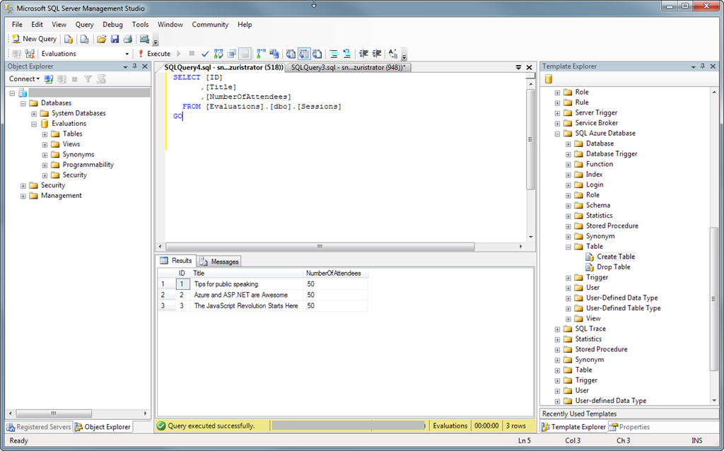
SQL Management Studio

Slide 14
SQL Management Studio
Download SQL Server 2014 Express:
http://www.microsoft.com/en-us/download/details.aspx?id=42299
Or try SQL Server 2016 if you like living on the edge:
http://www.microsoft.com/en-us/server-cloud/products/sql-server-2016/default.aspx?WT.mc_id=Blog_SQL_Announce_DI
Older versions (SQL 2012, SQL 2008, etc. all work fine too)
Notes:
http://www.microsoft.com/en-us/download/details.aspx?id=42299
http://www.microsoft.com/en-us/server-cloud/products/sql-server-2016/default.aspx?WT.mc_id=Blog_SQL_Announce_DI
http://www.microsoft.com/en-us/evalcenter/evaluate-sql-server-2016?WT.mc_id=Blog_SQL_Announce_DI

Slide 15
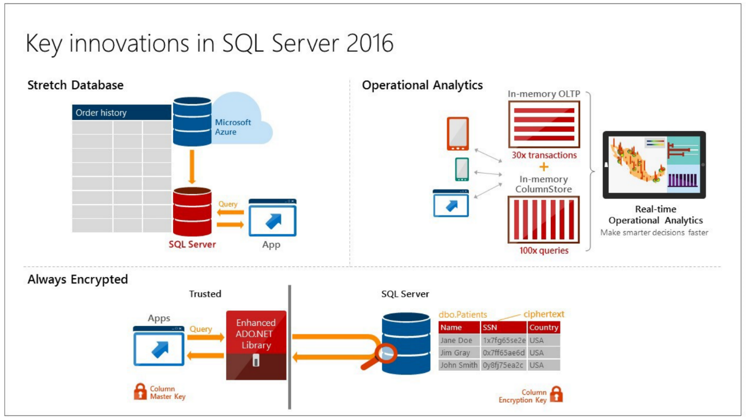
SQL Server 2016
Notes:
http://blogs.technet.com/b/dataplatforminsider/archive/2015/05/27/sql-server-2016-first-public-preview-now-available.aspx
http://www.microsoft.com/en-us/server-cloud/products/sql-server-2016/ (see pdf)

Slide 16
Creating Database Tables
Player (Account for each user)
Id (int, primary key, autoincrement)
Username (varchar(40))
LastLogin (DateTime)
Game
PlayerId
Score
HighScore
PlayerId
Score
Notes:
Let’s create a Database for Space Invaders with 3 tables. Why not everything in one table? Player accounts are created once and never updated except LastLogin, Games are just added and HighScore is sorted by the score, making it easy to display the highest scores. Each of the tables usually gets more and more complex over time.

Slide 17
Creating Database Tables
CREATE TABLE Player(
Id int NOT NULL IDENTITY (1, 1),
Username nvarchar(40) NOT NULL,
LastLogin timestamp NOT NULL
PRIMARY KEY (Id)
)
GO
Notes:
Let’s create a Database for Space Invaders with 3 tables. Why not everything in one table? Player accounts are created once and never updated except LastLogin, Games are just added and HighScore is sorted by the score, making it easy to display the highest scores. Each of the tables usually gets more and more complex over time.

Slide 18
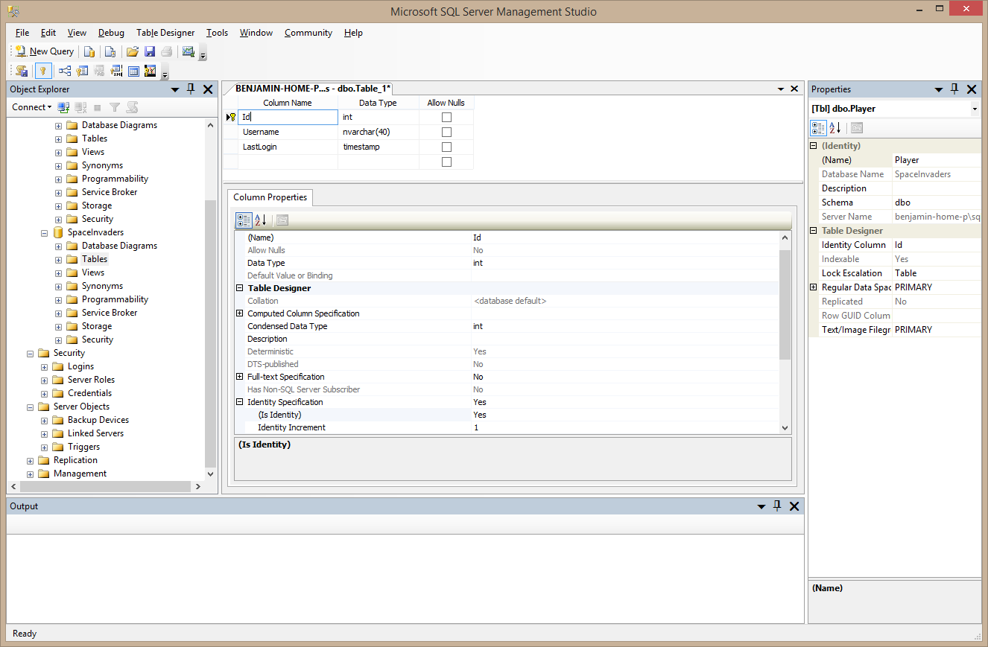
Creating Database Tables
Notes:
Same can be done with SQL Management Studio or even from inside Visual Studio

Slide 19
Programming the Server Side
SQL is not used on the client app
Instead we use networking to send data to the server side, which does the actual SQL
The server just waits for client messages and uses SQL to store and retrieve data
Notes:
https://en.wikipedia.org/wiki/SQL_injection

Slide 20
Programming the Server Side
In C# we have quite a few choices for SQL
System.Data.Sql (ADO.NET, see link)
System.Data.SqlClient
Using SqlConnection(connectionString)
Linq to SQL
System.Data.Odbc (useful for multiple/different dbs)
Third Party libraries
EntitySpaces, Blinq, eSQL, foxySQL, Msde
Microsoft.Jet.OLEDB
Notes:
http://www.dotnetperls.com/sqlclient
Also go through ADO.NET guide: http://www.certifiednetworks.com/utils/csharpdatabase.ppt

Slide 21
ADO.NET Components
SqlConnection
SqlDataAdapter
DataSet
DataTable
DataRow, DataColumn collections
SqlDataReader
SqlCommand

Slide 22
SQL Providers
SQL Server .NET Provider
OleDB .NET Provider
Example-AllRecordsBasicOleDB.aspx
ODBC .NET Provider
SQL XML .NET Provider

Slide 23
Connections
Connection Defined
Where to Store the Connection String
Connection Syntax Examples
Connection Pooling
Security
Close Your Connections!
Monitoring Connections

Slide 24
Connection String: Where to Store
Options Available:
Configuration Class
Front End App (.aspx file)
Web.Config
UDL File (OleDB Only)
Registry
Custom File
COM+ Catalog Using Connection Strings
Evaluation Terms: Security, Convenience, Performance

Slide 25
Connection String Syntax Examples
In the .aspx file:
ConnString = “server=10.0.0.1;UID=sa;PWD=;”
Dim Conn As New SqlConnection(ConnString)
In Web.Config XML file:
<configuration><appSettings>
<add key=“ConnString” value=“server=127.0.0.1;UID=sa;PWD=;”/>
</appSettings></configuration>

Slide 26
Connection Pooling
Defined
Controlling Min/Max
Importance of “Exact String Match”
Pooling for SqlClient vs. OleDBClient
Effects of pooling on SQL security
Close Your Connections

Slide 27
Performance Issues
Choose Providers Wisely
DataReader vs. DataAdapter
Repeater Control vs. DataGrid Control
Connection Pooling
Embedding SQL vs. Stored Procedures
Controlling The HTML
Typed Accessor Methods

Slide 28
DataReader Vs. DataAdapter
DataReader
Forward Only
Only One Record At A Time In Memory
“Firehose” Functionality
Typed Accessor Methods Avoid Conversions
One datareader open per connection
DataAdapter
More Overhead
More Flexible

Slide 29
SQL vs. Stored Procedures
Stored Proc Advantages:
Procedure Cache
Separate Security Model
Potentially Less Network Traffic
Output Params, Error Code & Result Set
Can Do Anything Server Side
Abstracts the Front End from Changes

Slide 30
SQL Recommendations
Use DataGrids Only When Updates Are Needed
Embed Connection In Web.Config through Config class
Only “Select” What You Need
Call StoredProcs For Ultimate Performance When “Paging”

Slide 31
SQL Live Programming
Using
System.Data assembly
System.Data.SqlClient namespace
SqlConnection
SqlCommand
DataReader
Notes:
Creating all code to make PongServer fully database driven, with test driven development (TDD)

Slide 32
Linq to SQL
Makes everything much easier
var playerId =
from player in database.Players
where player.Username == "User1"
select player.Id;
This is actually working C# .NET 4 code
Notes:
https://msdn.microsoft.com/en-us/library/bb386976%28v=vs.110%29.aspx?f=255&MSPPError=-2147217396
We will rewrite all of the database code using Linq to SQL via System.Data.Linq

Slide 33
Website
Simple website to show
high scores and
game statistics
Using ASP.NET and the existing PongServer Linq to SQL code

Slide 34
Advanced Database Topics
Indexing
Security
Optimizing Indices
Backup & Restore
SQL Scripts
SQL Injection Attacks
http://doublebuffered.com/2008/02/26/gdc-08-sql-considered-harmful
Notes:
https://en.wikipedia.org/wiki/SQL_injection
Also advanced topics we can go through if there is time: http://www.toptal.com/sql/interview-questions

Slide 35
Day 2: NoSQL
Forget everything we learned yesterday
https://www.mongodb.org/
“MongoDB is the next-generation database that lets you create applications never before possible.”
“MongoDB is an open-source document database that provides high performance, high availability, and automatic scaling.”
Notes:
https://en.wikipedia.org/wiki/MongoDB

Slide 36
MongoDB Features
Document-oriented
Ad hoc queries
Indexing
Replication
Load balancing
File storage
Aggregation

Slide 37
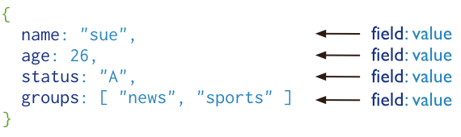
MongoDB Documents
MongoDB documents are similar to JSON objects
Notes:
https://docs.mongodb.org/manual/core/introduction/

Slide 38
MongoDB Primer
Insert:
db.things.save({name:"mongo"});
Select:
db.things.find({name:"mongo"});
Delete:
db.things.remove({name:"mongo"});
Update:
db.things.update({name:"mongo"},{name:"db"});
Notes:
http://www.devwebpro.com/a-mongo-primer-how-to-and-why-its-for-you/

Slide 39
MongoDB Editor: Mongo
MongoChef, cross-platform MongoDB GUI
BI Studio, Business Intelligence frontend for MongoDB.
Database Master, web-based client software, supports RDMS
Fang of Mongo, web-based UI, built with Django and jQuery
FusionReactor, Java based Application Monitor for MongoDB
Futon4Mongo, a clone of the CouchDB-Futon-Web-Interface for MongoDB
HumongouS.io, Web based GUI for MongoDB
mms, Mongo Management Studio, cross-platfrorm and web-based GUI
Mongo3, ruby-based GUI
MongoHub, a native OS-X-application for MongoDB management
NoSQL Manager for MongoDB, a MS Windows GUI application for MongoDB management with Shell
Opricot, browser-based MongoDB-Shell, implemented in PHP
Robomongo, Shell-centric cross-platform MongoDB management tool
SlamData, enables running SQL queries on a MongoDB database
UMongo (JMongoBrowser), cross-platform Management-GUI, implemented in Java
Notes:
We will be using MongoChef, showing installation, the tool and how to enter stuff

Slide 40
MongoDB and C#
MongoDB has official drivers for a variety of popular programming languages and development environments.
We will use nuget and the official MongoDB support.
Changing the SQL Code to MongoDB!

Slide 41
Questions?
All code and these slides are available at:
https://github.com/BenjaminNitschke/DatabaseCourse

Slide 42
Database & SQL Books
SQL Server 2016 Online Books
https://msdn.microsoft.com/en-us/library/ms130214.aspx
SQL: Crash Course
Troubleshooting SQL Server: A Guide for the Accidental DBA
SQL Server Backup and Restore
SQL Server Hardware
Notes:
http://www.sqlservercentral.com/Books/
There are many SQL and database books out there, I do not own a single one and you probably don’t need one either, everything can be found online and learning by doing is totally okay for SQL

Slide 43
Database Development Links
http://www.microsoft.com/en-us/server-cloud/products/sql-server-2016/
http://www.sqlservercentral.com/
http://www.dotnetperls.com/sqlconnection
http://doublebuffered.com/2006/10/30/why-sql-sucks-for-mmorpgs
https://www.mongodb.org/
https://en.wikipedia.org/wiki/Comparison_of_database_tools
https://en.wikipedia.org/wiki/MySQL
https://en.wikipedia.org/wiki/PostgreSQL

